Slide 1
Web Applications CT050-3-2 (VD1)
HTML5

Slide 2
Topic & Structure of The Lesson
Introduction to HTML & HTML5
HTML5 Structure
Headers
Linking
Images
Special Characters and More Line Breaks
Unordered Lists
Nested and Ordered Lists
Basic Tables
Basic Forms

Slide 3
Learning Outcomes
At the end of this topic, You should be able to
Understand important components of HTML5 documents.
Use HTML5 to create Web pages.
Add images to Web pages.
Understand how to create and use hyperlinks to navigate Web pages.
Mark up lists of information.
Write basic codes in HTML5

Slide 4
Key Terms You Must Be Able To Use
If you have mastered this topic, you should be able to use the following terms correctly in your assignments and exams:
HTML
HyperText Markup Language
The coded format used for creating hypertext documents on the World Wide Web and controlling how information is displayed
HTML5
Current version of HyperText Markup Language
Added new elements and features

Slide 5
Introduction to HTML
Universal standard hypertext language which formats documents and incorporates hypertext links to other documents stored on the same or different computers.
Provides a set of tags
<img>, <font>, <p> , <b>
Does not provide facility to define new tags.

Slide 6
Introduction to HTML
Tag
Name
Attribute
Name
Attribute
Value
<h1 align=“left”>Example Heading</h1>
Attribute
Affected Content
End Tag
Start Tag
HTML Element

Slide 7
Introduction to HTML5
HTML5 is the new standard for HTML.
HTML5 is still a work in progress, but most modern browsers have some HTML5 support.
HTML5 is a cooperation between the World Wide Web Consortium (W3C) and the Web Hypertext Application Technology Working Group (WHATWG).

Slide 8
Introduction to HTML5
Some rules for HTML5 :
> New features should be based on HTML,
CSS, DOM, and JavaScript
> Reduce the need for external plugins
> Better error handling
> More markup to replace scripting
> HTML5 should be device independent

Slide 9
Introduction to HTML5
New features :
> Canvas element for drawing
> Video/audio elements for media playback
> Better support for local offline storage
> New content specific elements like article, footer, header, nav, section
> New form controls like calendar, date, time, email, url, search

Slide 10
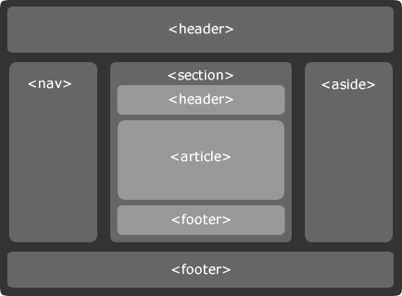
New Elements in HTML5

Slide 11
DOCTYPE in HTML5
The DOCTYPE declaration in XHTML :
Previous versions of HTML defined a lot of doctypes, and choosing the right one could be tricky. In HTML5, there is only one DOCTYPE :
<!DOCTYPE html PUBLIC "-//W3C//DTD XHTML 1.0 Transitional//EN"
"http://www.w3.org/TR/xhtml1/DTD/xhtml1-transitional.dtd">
<!DOCTYPE html>

Slide 12
Editing HTML5
HTML5 documents
Source-code form
Text editor (e.g. Notepad, Wordpad, emacs, etc.)
.html or .htm file-name extension
Web server
Stores HTML5 documents
Web browser
Requests HTML5 documents

Slide 13
First HTML5 Example
HTML5 comments
Start with <!-- and end with -->
html element
head element
Head section
Title of the document
Style sheets and scripts
body element
Body section
Page’s content the browser displays
Start tag
attributes (provide additional information about an element)
name and value (separated by an equal sign)
End tag

Slide 14
First HTML5 Example
<!DOCTYPE html>
<html>
<head>
<meta charset="utf-8">
<title>HTML5 sure is fun</title>
</head>
<body>
<p>HTML5 is fun!!</p>
</body>
</html>

Slide 15
The Rules of HTML5
HTML is not case sensitive, HTML5 is
<b>, <B> are the same under HTML.
<p ALIGN=“center”> and <p align=“center”> are also the same
HTML/HTML5 attribute values may be case sensitive
<img src=“test.gif”> is the same as <img SRC=“test.gif”> under HTML
<img src=“test.gif”> may not be same as <img src=“TEST.GIF”> in HTML5.
HTML5 elements should be nested not crossed.
Nested = Good <b><i>This is bold and italic</i></b>
Crossed = Bad <b><i>Don’t do this</b></i>

Slide 16
Headers
Six headers ( header elements)
h1 through h6

Slide 17
Headers
<!DOCTYPE html>
<html>
<head>
<meta charset="utf-8">
<title>Header</title>
</head>
<body>
<h1>Level 1 Header</h1>
<h2>Level 2 Header</h2>
<h3>Level 3 Header</h3>
<h4>Level 4 Header</h4>
<h5>Level 5 Header</h5>
<h6>Level 6 Header</h6>
</body>
</html>

Slide 18
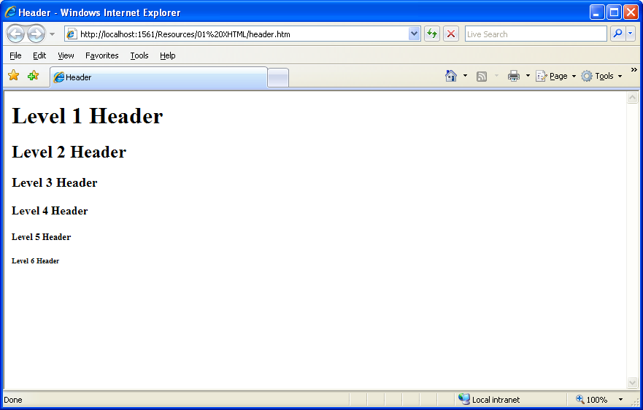
Headers
<h1>Level 1 Header</h1>
<h2>Level 2 Header</h2>
<h3>Level 3 Header</h3>
<h4>Level 4 Header</h4>
<h5>Level 5 Header</h5>
<h6>Level 6 Header</h6>

Slide 19
Linking
Hyperlink
References other sources such as XHTML documents and images
Both text and images can act as hyperlinks
Created using the a (anchor) element
Attribute href
Specifies the location of a linked resource
Link to e-mail addresses using mailto: URL
<strong> tag
Bold
br element
Line break

Slide 20
Linking
<!DOCTYPE html>
<html>
<head>
<meta charset="utf-8">
<title>Linking</title>
</head>
<body>
<strong>Click a name to go to that page</strong>
<br />
<br />
<a href="http://www.google.com">Google</a><br />
<a href="http://www.yahoo.com">Yahoo</a><br />
<a href="http://validator.w3.org">W3C Markup Validation Service </a>
</body>
</html>

Slide 21
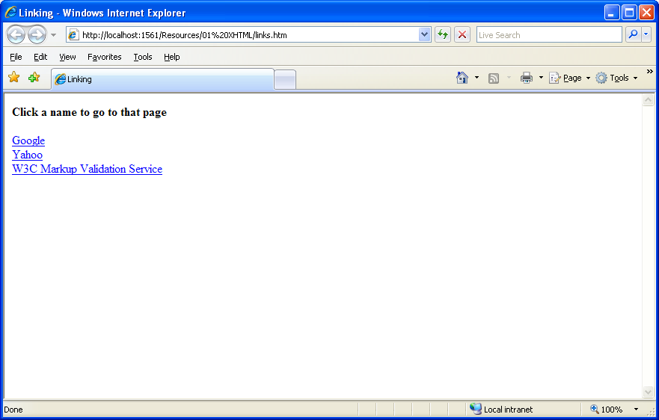
Linking

Slide 22
Linking
<!DOCTYPE html>
<html>
<head>
<meta charset="utf-8">
<title>Linking</title>
</head>
<body>
Click <a href="mailto:name@email.com">here</a> to send an email to me.
</body>
</html>

Slide 23
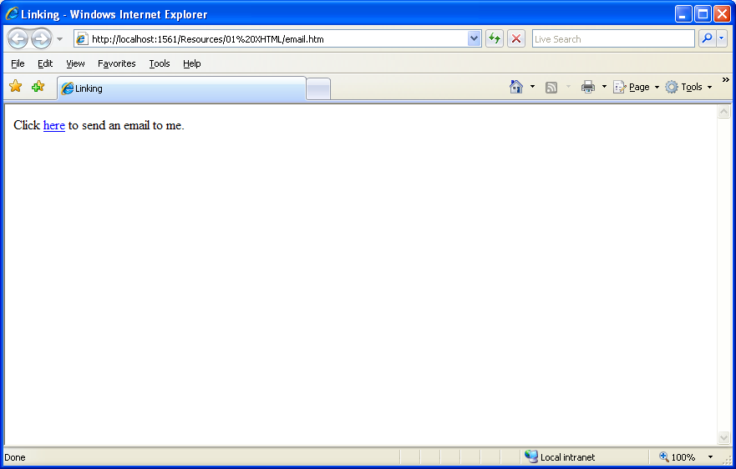
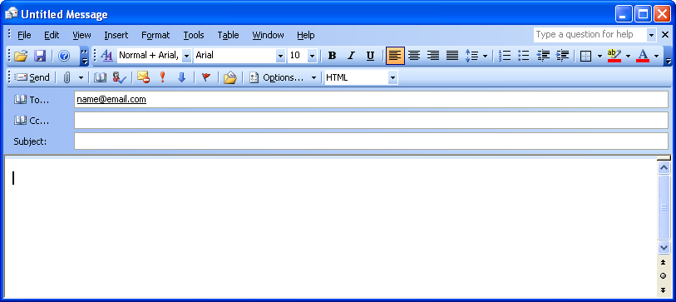
Linking

Slide 24
Images
Three most popular formats
Graphics Interchange Format (GIF)
Joint Photographic Experts Group (JPEG)
Portable Network Graphics (PNG)
img element
src attribute
Specifies the location of the image file
width and height
Pixels (“picture elements”)
Empty elements
Terminated by character / inside the closing right angle bracket (>), or by explicitly including the end tag

Slide 25
Images
<!DOCTYPE html>
<html>
<head>
<meta charset="utf-8">
<title>Images</title>
</head>
<body>
<img src="princess.jpg" width="640" height="360" alt="PrincessL"/>
<img src="princess.jpg" width="356" height="200" alt="PrincessM"/>
<img src="princess.jpg" width="228" height="128" alt="PrincessS"/>
</body>
</html>

Slide 26
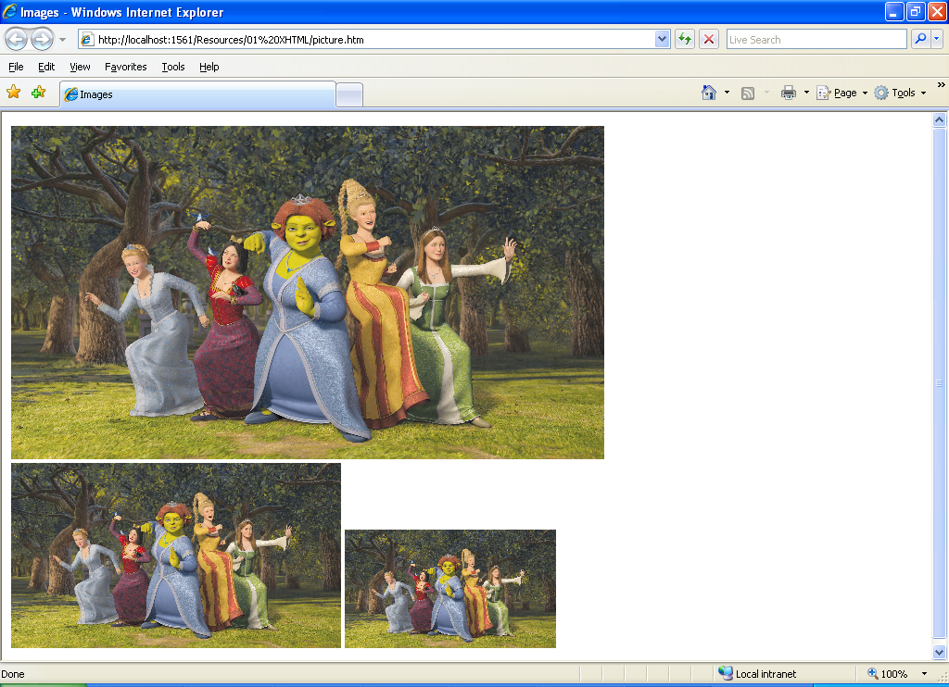
Images

Slide 27
Images
<!DOCTYPE html>
<html>
<head>
<meta charset="utf-8">
<title>Linking</title>
</head>
<body>
<strong>Click a picture to go to that page</strong>
<br />
<br />
<a href="http://www.google.com"><img src="google.gif" /></a><br />
<a href="http://www.yahoo.com"><img src="yahoo.gif" /></a><br />
<a href="http://validator.w3.org"><img src="w3c-valid-xhtml.png" /></a>
</body>
</html>

Slide 28
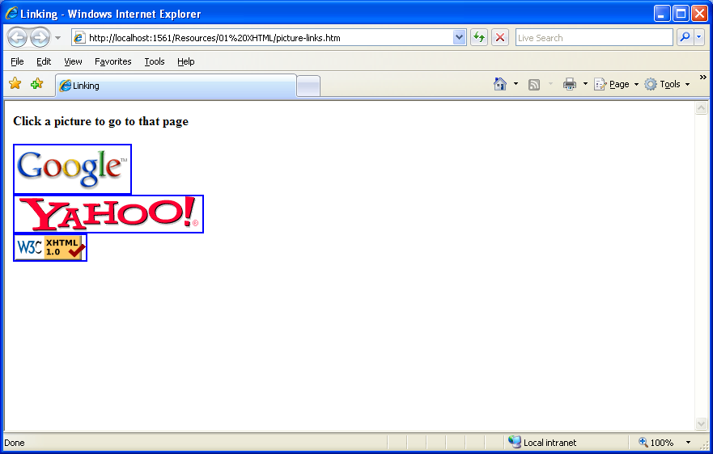
Images

Slide 29
Special Characters and More Line Breaks
Character entity references
Numeric character references
del
Strike-out text
sup
Superscript text
sub
Subscript text
<hr />
Horizontal rule (horizontal line)

Slide 30
Special Characters and More Line Breaks
<!DOCTYPE html>
<html>
<head>
<meta charset="utf-8">
<title>Special Characters and More Line Breaks</title>
</head>
<body>
<p>Special Characters and More Line Breaks</p>
<hr /> <!-- inserts a horizontal rule -->

Slide 31
Special Characters and More Line Breaks
<!-- to strike through text use <del> tags -->
<!-- to subscript text use <sub> tags -->
<!-- to superscript text use <sup> tags -->
<!-- these tags are nested inside other tags -->
<p><del>This is strike through</del></p>
<p>Superscript: 3.14 x 10<sup>2</sup></p>
<p>Subscript: H<sub>2</sub>O</p>
<!-- special characters are entered using the form &code; -->
<p>Half: <strong> &frac12;</strong></p>
<p>Quater: <strong> &frac14;</strong></p>
<p>Copyright: <strong>&copy;</strong></p>
<hr /> <!-- inserts a horizontal rule -->
</body>
</html>

Slide 32
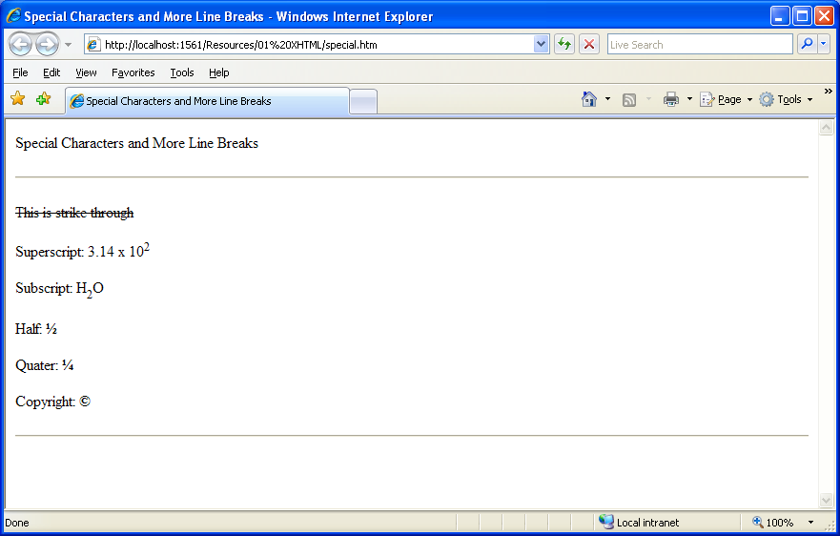
Special Characters and More Line Breaks

Slide 33
Unordered Lists
Unordered list element ul
Creates a list in which each item begins with a bullet symbol (called a disc)
li (list item)
Entry in an unordered list

Slide 34
Unordered Lists
<!DOCTYPE html>
<html>
<head>
<meta charset="utf-8">
<title>Unordered Lists</title>
</head>
<body>
Here are my favorite fruits<br />
<ul>
<li>Banana</li>
<li>Coconut</li>
<li>Papaya</li>
</ul>

Slide 35
Unordered Lists
<p>Here are my favorite sites</p>
<ul>
<li><a href="http://www.google.com">Google</a></li>
<li><a href="http://www.yahoo.com">Yahoo</a></li>
<li><a href="http://www.msn.com">MSN</a></li>
</ul>
</body>
</html>

Slide 36
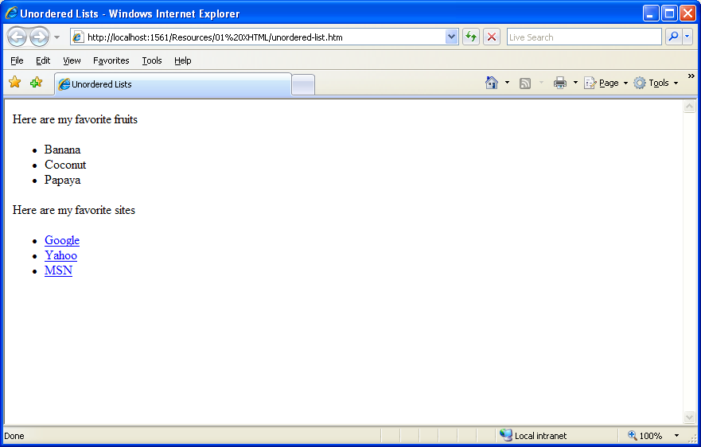
Unordered Lists

Slide 37
Nested and Ordered Lists
Represent hierarchical relationships
Ordered lists (ol)
Creates a list in which each item begins with a number

Slide 38
Nested and Ordered Lists
<!DOCTYPE html>
<html>
<head>
<meta charset="utf-8">
<title>Nested List</title>
</head>
<body>
<h1>The Best Features of the Internet</h1>
<!-- create an unordered list -->
<ul>
<li>You can meet new friend from countries around the world. </li>
<li>You have access to new media as it becomes public:

Slide 39
Nested and Ordered Lists
<!-- this starts a nested list, which uses a -->
<!-- modified bullet. The list ends when you -->
<!-- close the <ul> tag. -->
<ul>
<li>New games </li>
<li>New applications
<!-- nested ordered list -->
<ol>
<li>For business </li>
<li>For fun </li>
</ol>
</li>
<li>Around the clock news </li>
<li>Search engines </li>

Slide 40
Nested and Ordered Lists
<li>Shopping </li>
<li>Programming
<!-- another nested ordered list -->
<ol>
<li>XHTML </li>
<li>C#&nbsp;</li>
<li>XML&nbsp;</li>
<li>JavaScripts </li>
<li>New languages </li>
</ol>
</li>
</ul>
<!-- ends the nested list of line 27 -->
</li>

Slide 41
Nested and Ordered Lists
<li>Links </li>
<li>Keeping in touch with old friends </li>
<li>It is the technology of the future! </li>
</ul>
</body>
</html>

Slide 42
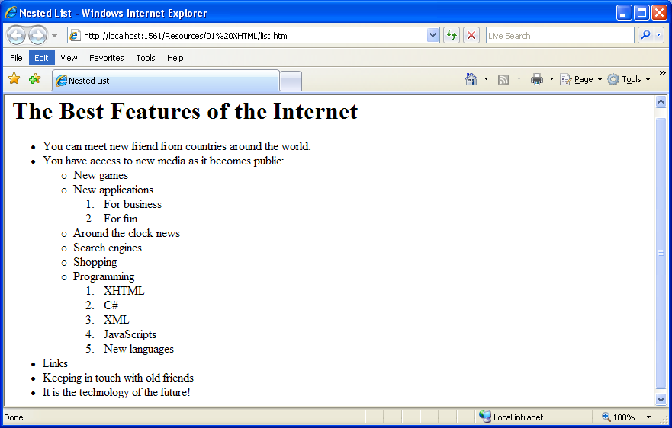
Nested and Ordered Lists

Slide 43
Basic Tables
Tables
Present information
Organize data into rows and columns
table element
Attribute border
Specifies the table’s border width in pixels
Attribute summary
Describes the table’s contents
Attribute caption
Describes the table’s content and helps text-based browsers interpret table data

Slide 44
Basic Tables
table element
Head section (header cell, defined with a thead element)
Contains header information such as column names
tr element (defines an individual table row)
th element (defines the columns in the head section)
Foot section (defined with a tfoot element)
Table body (defined with a tbody element)
Data cells (defined with td element)

Slide 45
Basic Tables
<!DOCTYPE html>
<html>
<head>
<meta charset="utf-8">
<title>Creating a Basic Table</title>
</head>
<body>
<table border="1" summary="This table provides information about the price of fruit" width="40%">
<caption>
Price of Fruit
</caption>
<!-- the <thead> is the first section of a table -->
<!-- it formats the table header area -->

Slide 46
Basic Tables
<thead>
<!-- <tr> inserts a table row -->
<tr>
<!-- insert a heading cell -->
<th>Fruit</th>
<th>Price</th>
</tr>
</thead>
<!-- the <tfoot> is the last section of a table -->
<!-- it formats the table footer -->
<tfoot>
<tr>
<th>Total</th>
<th>$3.75</th>
</tr>
</tfoot>

Slide 47
Basic Tables
<!-- all table content is enclosed within the <tbody> -->
<tr>
<!-- insert a data cell -->
<td>Apple</td>
<td>$0.25</td>
</tr>
<tr>
<td>Orange</td>
<td>$0.50</td>
</tr>
<tr>
<td>Banana</td>
<td>$1.00</td>
</tr>

Slide 48
Basic Tables
<tr>
<td>Pineapple</td>
<td>$2.00</td>
</tr>
</table>
</body>
</html>

Slide 49
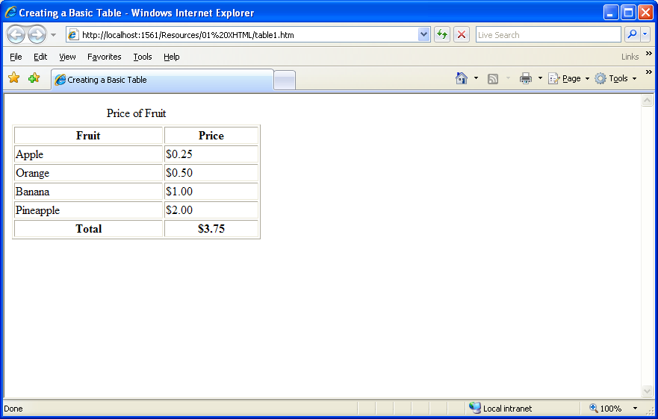
Basic Tables

Slide 50
Intermediate Tables and Formatting
Element colgroup
Groups and formats columns
Element col
Attribute align
Determines the alignment of text in the column
Attribute span
Determines how many columns the col element formats
rowspan and colspan
Specify the number of rows or columns occupied by a cell
valign
Aligns data vertically
One of the four values: “top”, “middle”, “bottom”, “baseline”

Slide 51
Intermediate Tables and Formatting
<!DOCTYPE html>
<html>
<head>
<meta charset="utf-8">
<title>Untitled Page</title>
</head>
<body>
<h1>Table Example Page</h1>
<table border="1">
<caption> Here is a more complex sample table.</caption>
<!-- <colgroup> and <col> tags are used to format entire columns -->
<colgroup>
<!-- span attribute determines how many columns the <col> tag affects -->
<col align="right" />
</colgroup>

Slide 52
Intermediate Tables and Formatting
<thead>
<!-- rowspans and colspans merge the specified number of cells vertically or horizontally -->
<tr>
<th rowspan="2"><!-- merge two rows --><img src="shrek.gif" height="192" />&nbsp;</th>
<th colspan="4" valign="top"> <!-- merge four columns -->
<h1>Shrek</h1><br />
<p>As for 2007</p>
</th>
</tr>
<tr valign="bottom">
<th>Shrek 1 (2001)</th>
<th>Shrek 2 (2004)</th>
<th>Shrek 3 (2007)</th>
<th>Shrek 4 (?)</th>
</tr>
</thead>

Slide 53
Intermediate Tables and Formatting
<tr>
<th>VCD</th>
<td>Available</td>
<td>Available</td>
<td>Not Available</td>
<td>Not Available</td>
</tr>
<tr>
<th>DVD</th>
<td>Available</td>
<td>Available</td>
<td>Not Available</td>
<td>Not Available</td>
</tr>
</table>
</body>
</html>

Slide 54
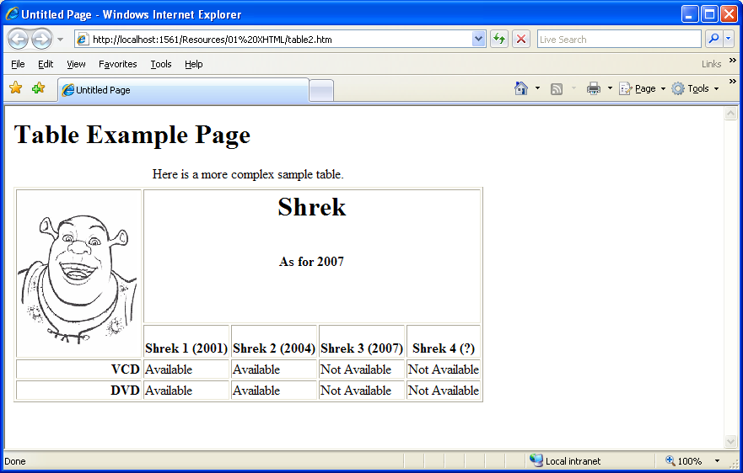
Intermediate Tables and Formatting

Slide 55
Basic Forms
Element form
Attribute method
Specifies how the form’s data is sent to Web server
method = “post”
Appends form data to the browser request
method = “get”
Appends form data directly to the end of the URL
Attribute action
Specifies the URL of a script on the Web server
input
Specifies data to provide to the script that processes the form

Slide 56
Basic Forms
<!DOCTYPE html>
<html>
<head>
<meta charset="utf-8">
<title>Untitled Page</title>
</head>
<body>
<h1>
Feedback Form</h1>
<p>
Please fill out this form to help us improve our site.</p>
<!-- this tag starts the form, gives the -->
<!-- method of sending information and the -->
<!-- location of form scripts -->

Slide 57
Basic Forms
<form action=“formmail.html" method="post">
<p>
<label> Name: </label>
<input type = “text” maxlength="30" name=“nm" size="25" />
</p>
<p>
<!-- input types "submit" and "reset" insert -->
<!-- buttons for submitting and clearing the -->
<!-- form's contents -->
<input type="submit" value="Submit Your Entries" />
<input type="reset" value="Clear Your Entries" />
</p>
</form>
</body>
</html>

Slide 58
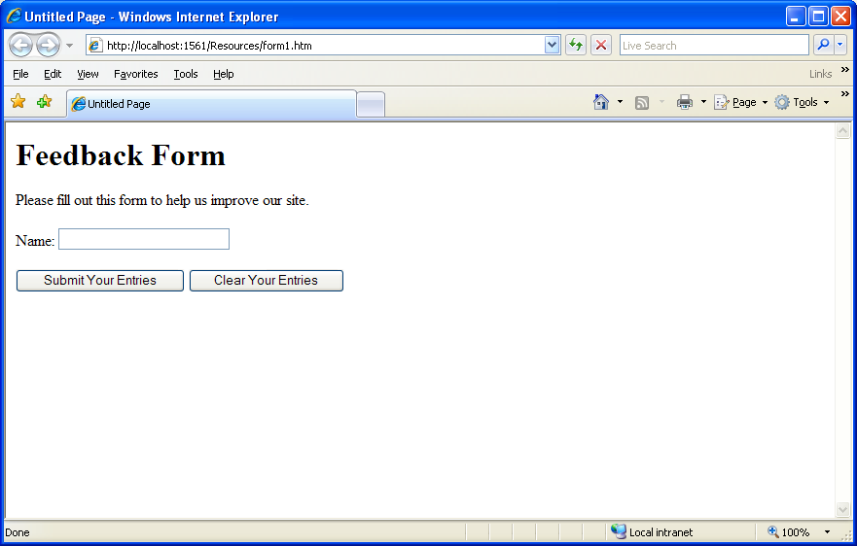
Basic Forms

Slide 59
More Complex Form
Element textarea
Inserts a multiline text box (text area)
Attribute rows
Specifies the number of rows
Attribute cols
Specifies the number columns
Input “password”
Inserts a password box with the specified size
Element checkbox
Enable users to select from a set of options
Element select
Provides a drop-down list of items
Element option
Adds items to the drop-down list

Slide 60
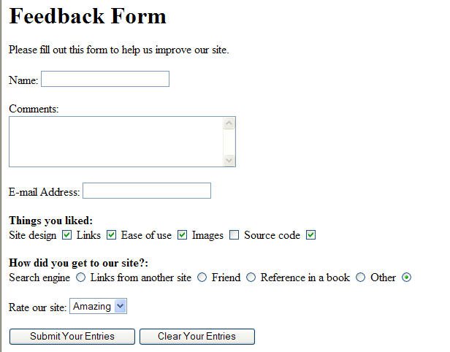
Quick Review Question
Create the following form

Slide 61
Summary of Main Teaching Points
HTML5 structure
HTML5 elements
Images
Links
Table
Form

Slide 62
Question and Answer Session
Q & A

Slide 63
What we will cover next
CSS

